Slide 1
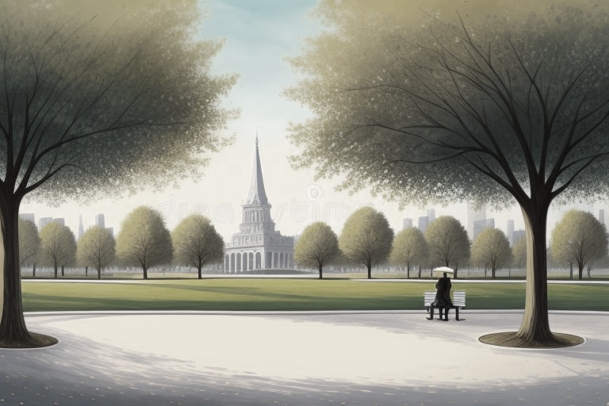
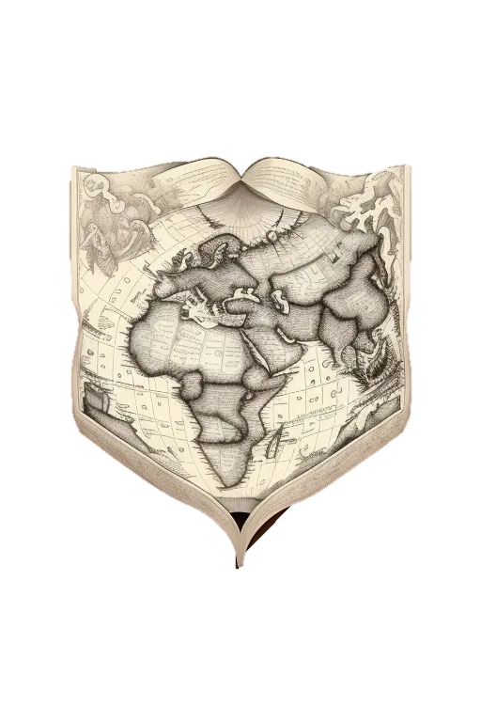
Conversational English
Episode 1
A New Beginning

Slide 2



Slide 3


Slide 17
Key Vocabulary
Key Grammar
Lost
City center
Fountain
Square
Turn right
I’m Alex.
Do you need help?

